Slide 1

SQL Project On
Food Delivery Data Analysis
BY : RAVINDRA NADH . Y

Slide 2

Introduction
Project Overview:
1. Developed a comprehensive SQL database for a food delivery system
2. Efficiently manages customers, restaurants, delivery partners, orders
& menu
Key Entities & Tables:
Customers
Restaurants
Delivery Partners
Menu Items
Orders
Order Details
Business Insights & Analytics:
1. Identify top customers & high-value orders
2. Find popular restaurants, cuisines, and menu items
3. Enable data-driven decision-making for food delivery

Slide 3

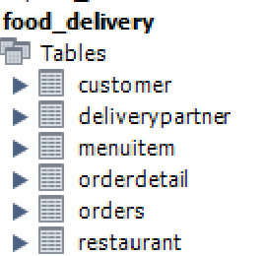
Creating Tables:
The project starts by creating structured tables to store food delivery data:
Customer
Restaurant
DeliveryPartner
MenuItem
Orders
OrderDetail
To maintain data accuracy and establish relationships, primary keys &
foreign keys are implemented.

Slide 4
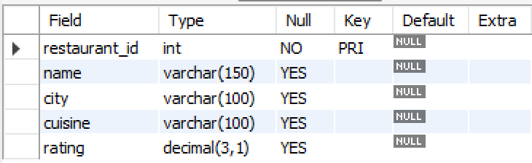
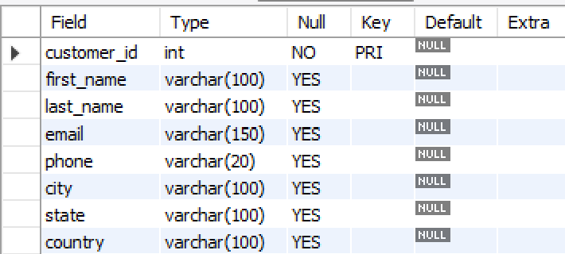
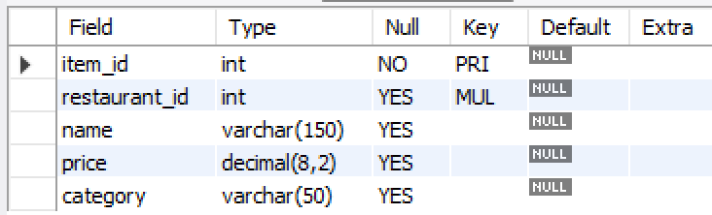
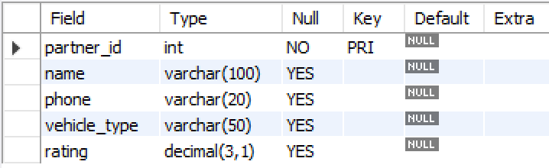
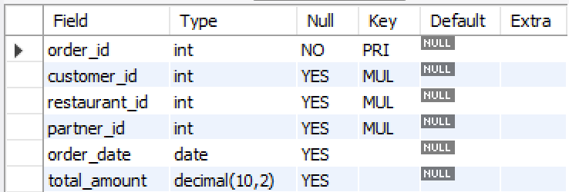
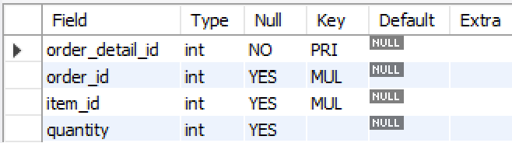
Tables:
Restaruant:
Customers:
Menu items:
Delivery partner:
Orders:
OrderDetails:

Slide 5

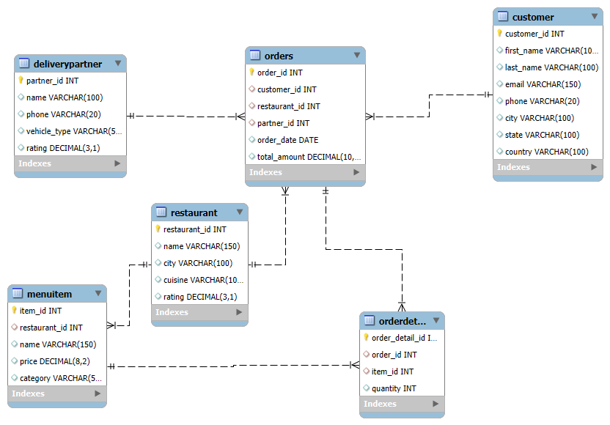
ER Diagram:

Slide 6
ER Diagram Discription
Core Entities: 6 main tables - Customer, Restaurant, DeliveryPartner, MenuItem, Orders, OrderDetail
Relational Structure: Foreign keys ensure data integrity and connect orders with customers, restaurants, and delivery partners.
Sales Flow: Orders link customers to restaurants & delivery partners. OrderDetail captures each menu item purchased.
Efficient Design: Use of data types (INT, VARCHAR, DECIMAL) ensures accuracy and optimized storage.

Slide 7

Importing Data :
Data Import Strategy:
1.Bulk Import using CSV files for large datasets
2.Ensures structured and systematic data insertion
3.Verified relationships after loading to ensure data integrity
4.Supports customization & validation for accuracy

Slide 8

Problem Statement
Food delivery data was scattered and lacked a structured system to
manage customers, restaurants, orders, and delivery partners.
Challenges included:
- Tracking customer spending and top customers
- Identifying best-selling items and popular cuisines
- Finding revenue-generating restaurants
- Managing delivery partner performance
Solution: Designed and implemented a relational SQL database with queries
to extract meaningful insights.

Slide 9

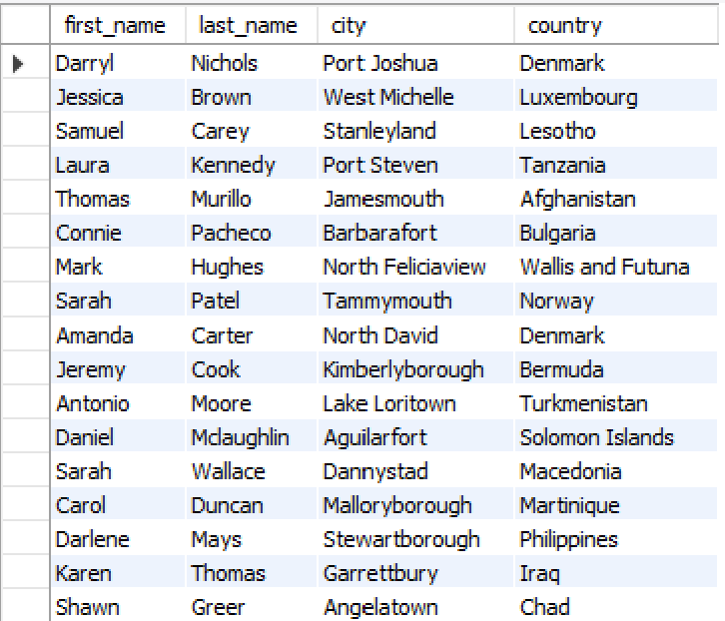

Queries
Q1:We want to understand our customer base better — can we list all customers along with their city and country?
Output:
Query:

Slide 10

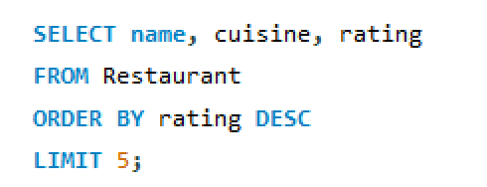
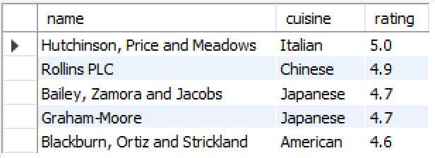
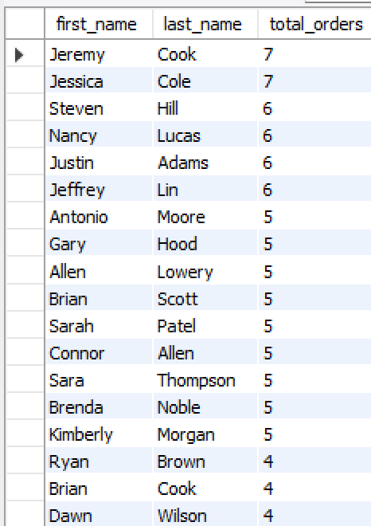
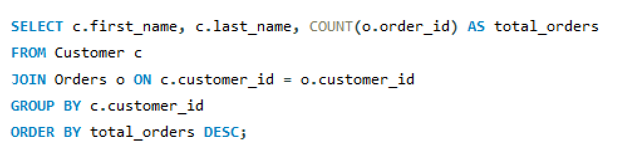
Q2:If we want to promote only the best-performing restaurants, which are the top 5 restaurants based on customer ratings?
Query:
Output:
Q3: To measure customer loyalty, how many orders has each customer placed so far?
Query:
Output:

Slide 11
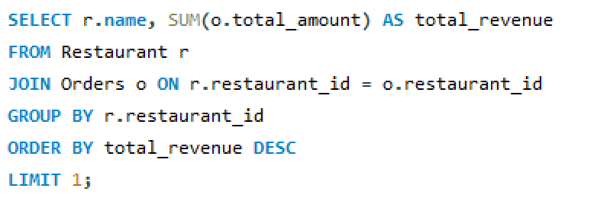
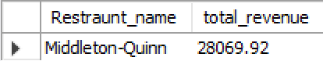
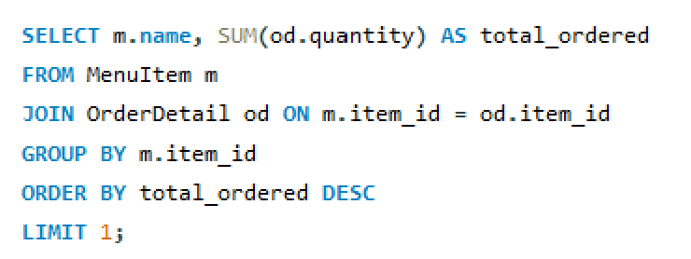
Q4: Which restaurant is contributing the most revenue to our platform, so we can strengthen our partnership with them?
Query:
Output:
Q5: What is the single most popular menu item that customers order again and again?
Query:
Output:

Slide 12
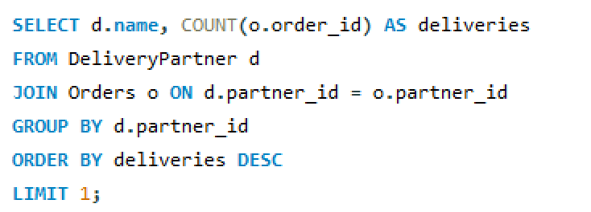
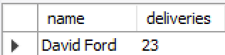
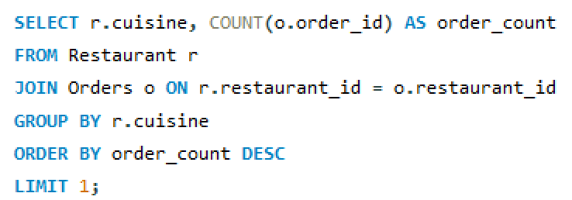
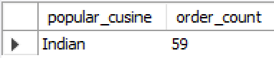
Q6: Who is our busiest delivery partner in terms of completed deliveries?
Query:
Output:
Q7: Which cuisine is the most popular among customers, based on the number of orders?
Query:
Output:

Slide 13
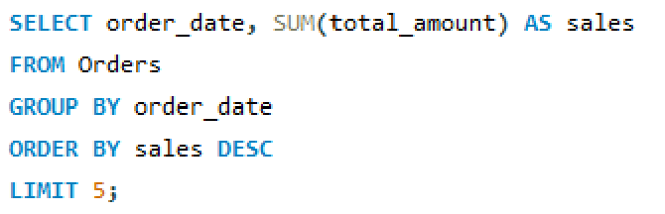
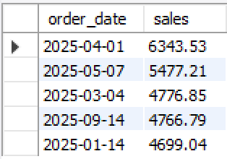
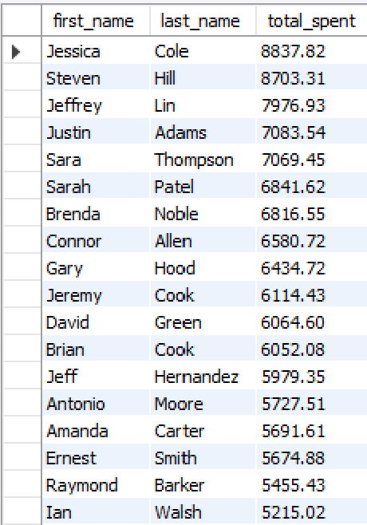
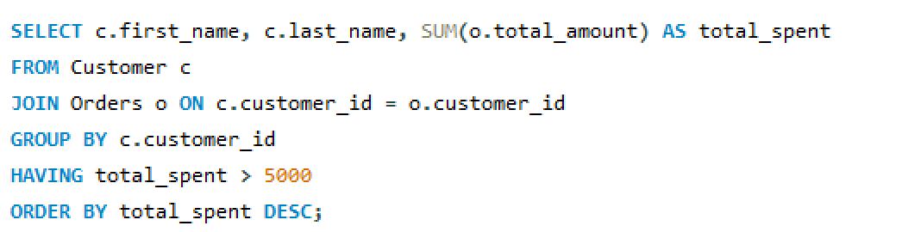
Q8: On which days did we record the highest sales, and what are the top 5 revenue days?
Query:
Output:
Q9: We are planning to reward premium customers — who are the customers that have spent more than 5000 in total?
Query:
Output:

Slide 14
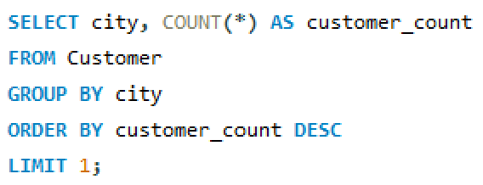
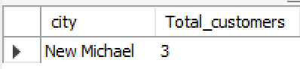
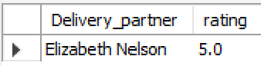
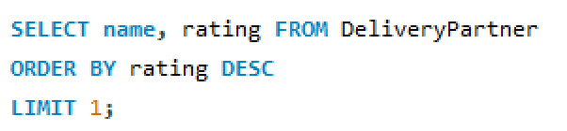
Q10: Which city has the largest number of customers using our service?
Query:
Output:
Q11: Among delivery partners, who has the highest average rating for service quality?
Output:
Query:

Slide 15
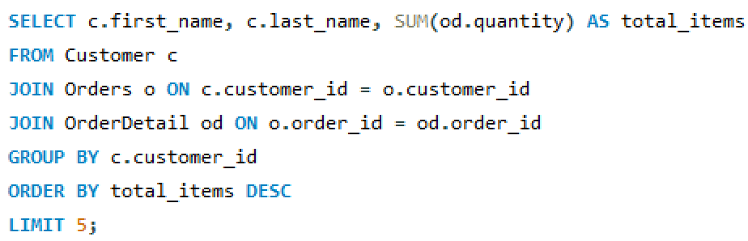
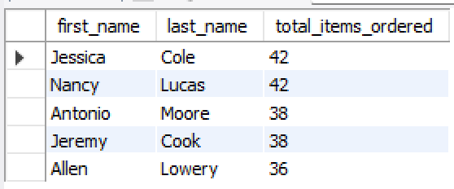
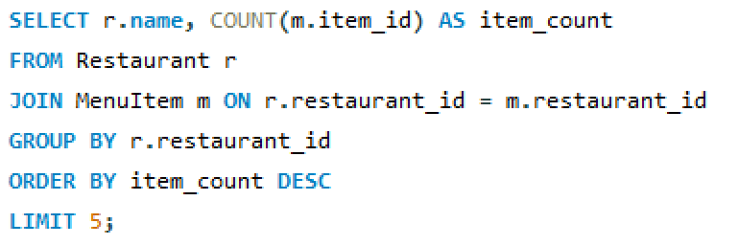
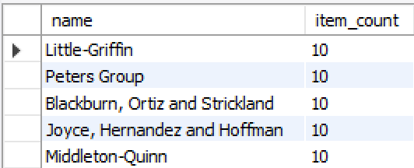
Q12: Who are the top 5 customers who ordered the most food items overall?
Query:
Output:
Q13: Which restaurants offer the widest variety of food items on their menu, and who are the top 5?
Query:
Output:

Slide 16
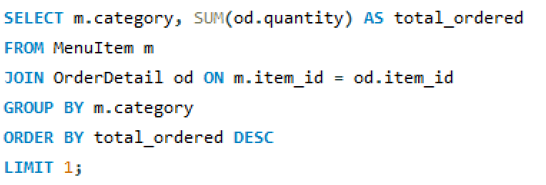
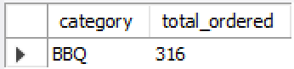
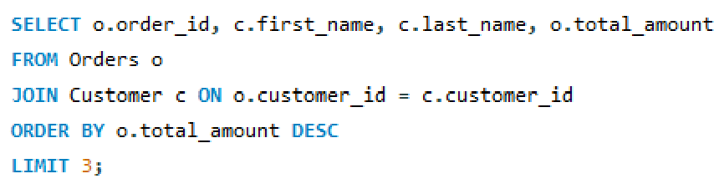
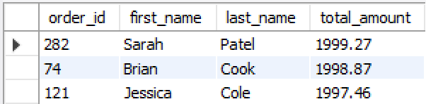
Q14: Which food category (like pizza, desserts, etc.) is ordered the most by our customers?
Query:
Output:
Q15: Which are the top 3 highest-value orders, and which customers placed them?
Query:
Output:

Slide 17
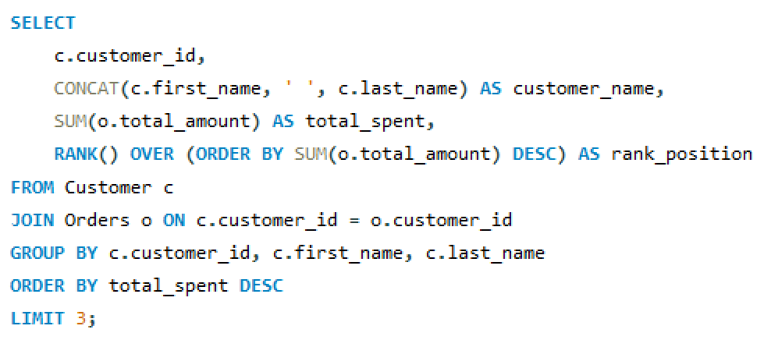
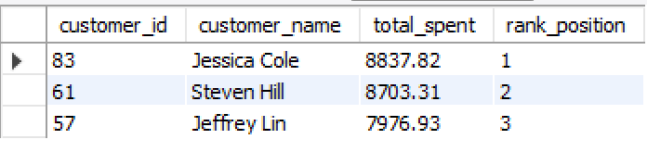
Q16: Who are our top 3 customers by spending, if we rank all customers based on total money spent?
Advanced Queries
Query:
Output:

Slide 18
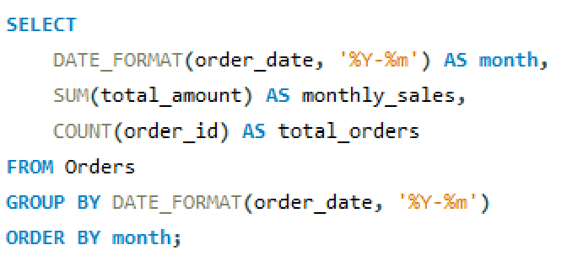
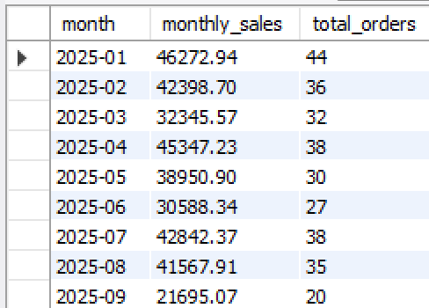
Q17: How have our sales trended month by month — are there any patterns or seasonal spikes?
Query:
Output:

Slide 19
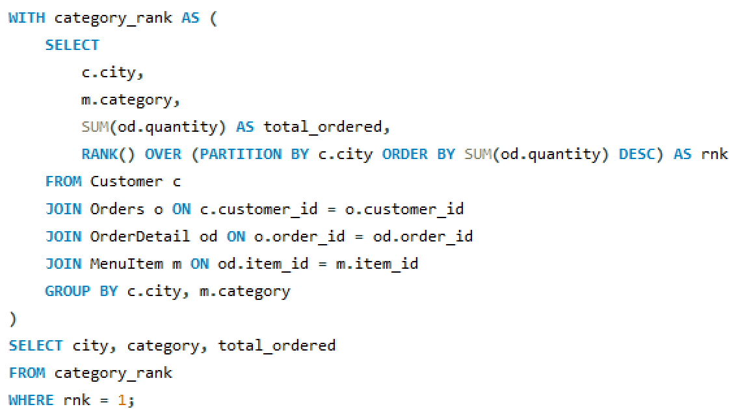
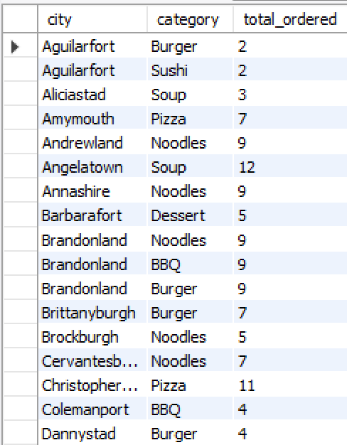
Q18: What is the most popular food category in each city, so we can customize offers regionally?
Query:
Output:

Slide 20
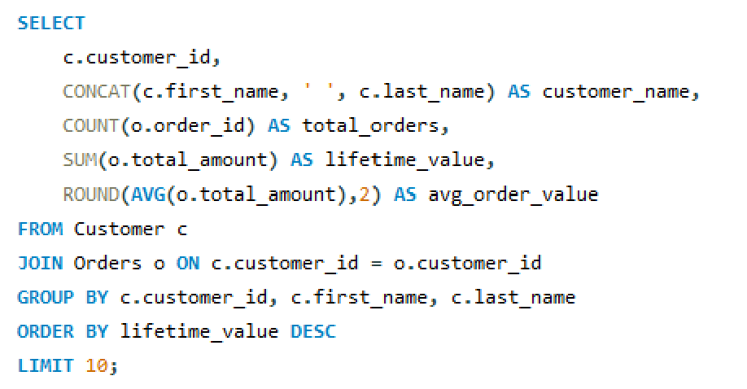
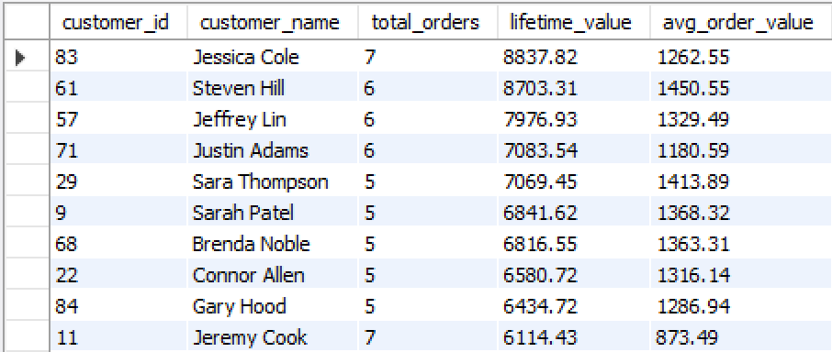
Q19: What is the Customer Lifetime Value (CLV) for each customer — how much do they spend overall, and on average per order?
Query:
Output:

Slide 21
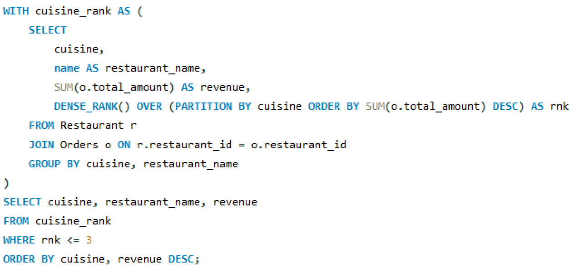
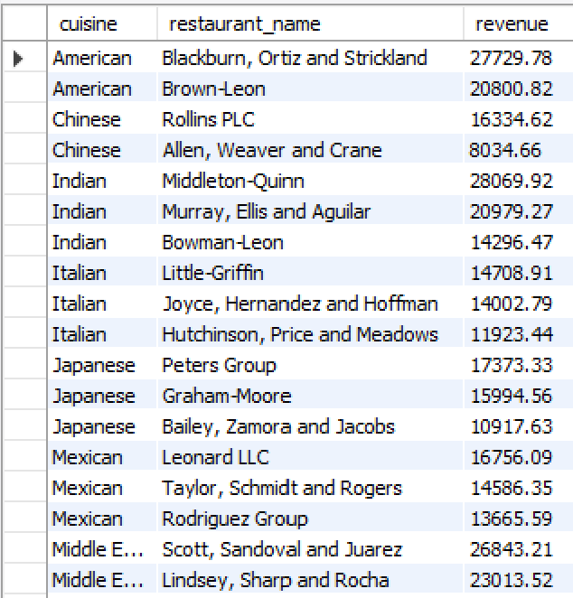
Q20: Within each cuisine type, which are the top 3 restaurants contributing the most revenue?
Query:
Output:

Slide 22

Project Insights
Identified top customers and high-value orders
Found most popular restaurants, cuisines, and menu items
Discovered busiest delivery partners
Analyzed daily and monthly sales trends
Calculated customer lifetime value (CLV)
Highlighted categories and cuisines driving most revenue

Slide 23
Recommendations:
Focus promotions on high-spending customers
Partner with top-rated restaurants
Optimize delivery partner allocation based on performance
Promote most popular cuisines and menu categories
Use CLV insights to design loyalty programs
Analyze seasonal sales trends for campaign planning

Slide 24
Conclusion
This project demonstrates how SQL can transform raw food delivery data into actionable business insights. With structured tables, joins, CTEs, and advanced queries, we identified revenue drivers, customer behavior, and delivery efficiency.
The project provided practical experience with advanced SQL techniques, helping businesses make data-driven decisions for marketing, operations, and customer engagement.

Slide 25


